Slide 1
FinTech Data: Key
Insights
DS Diploma - Data Engineering Milestone 2
With Apache Airflow and Superset
Nadeen Emadeldin 34-7775

Slide 2
Outline
01
EDA
About the Data
Answering the five questions
02
Primary Insights: Milestone 1
Correlations
Descriptive Stats
03
Further Findings: Milestone 2
The Functions
Airflow DAGs – The pipeline
Dashboard (Superset)

Slide 3
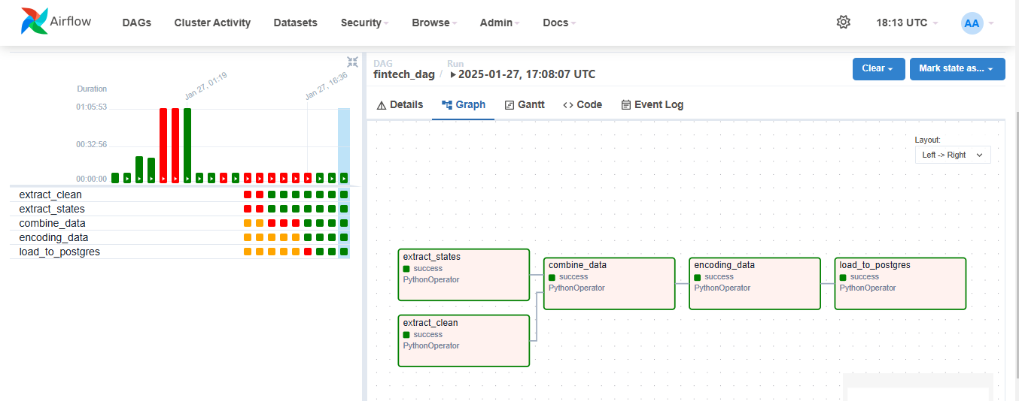
Airflow DAGs

Slide 4
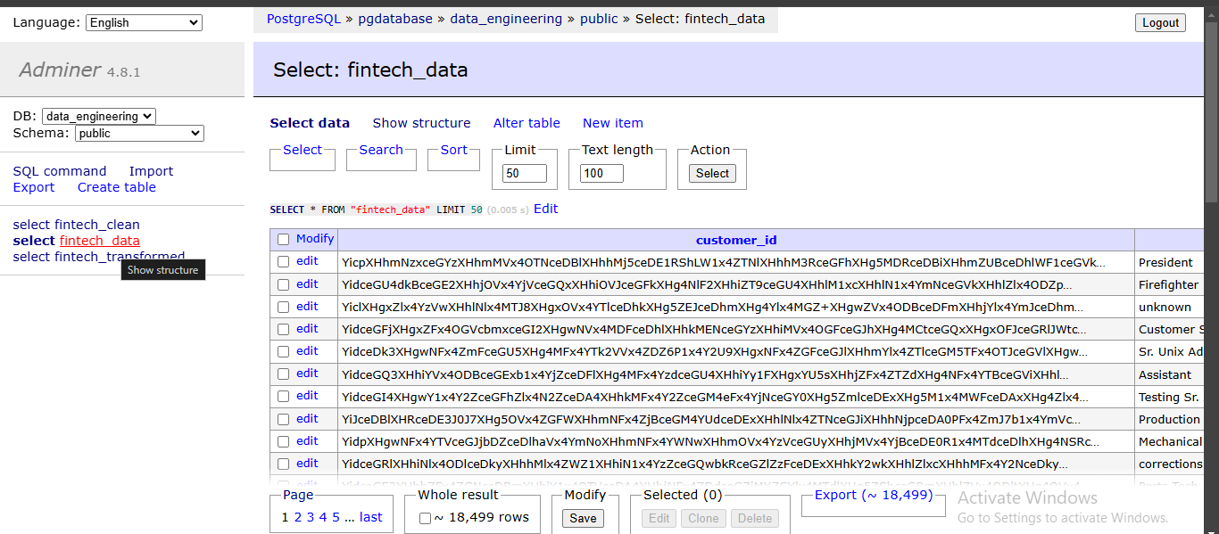
Adminer

Slide 5
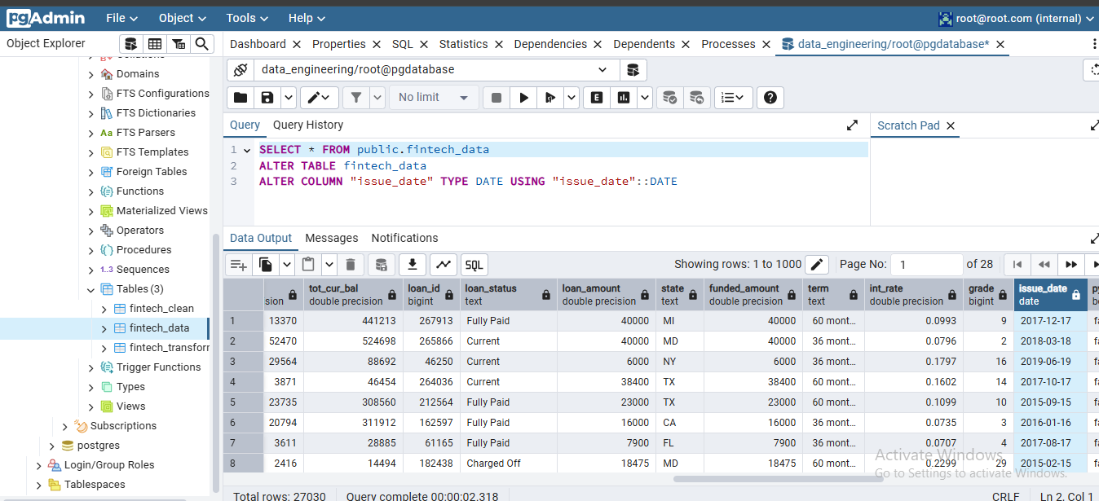
Pgadmin: Running SQL Queries

Slide 6
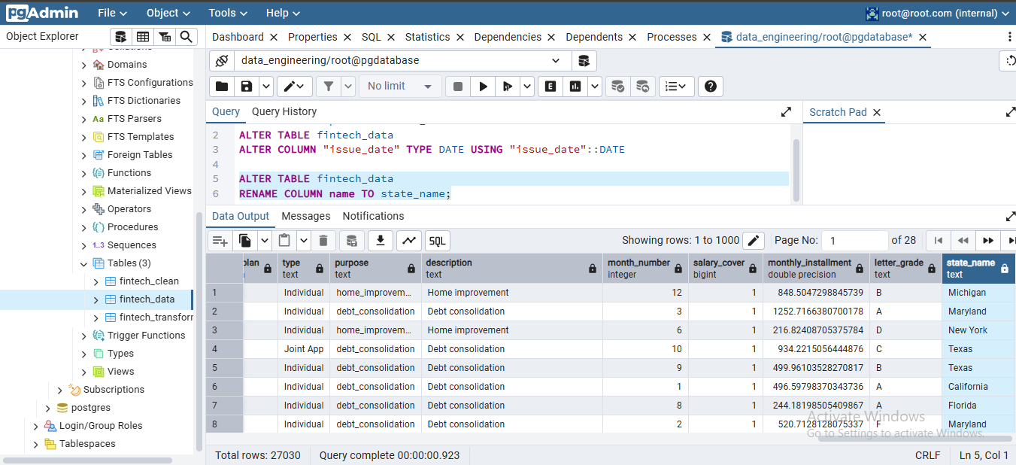
Pgadmin: Running SQL Queries

Slide 7
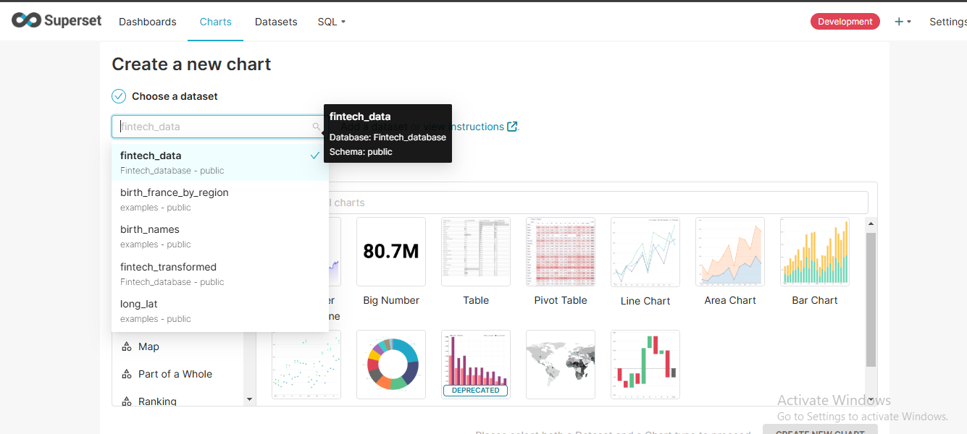
Superset: Database and Dataset Created

Slide 8
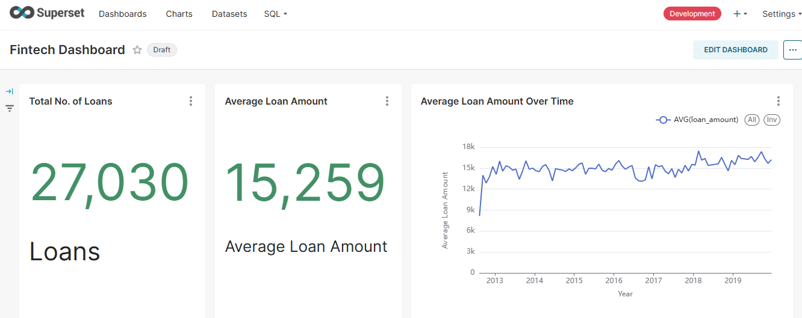
Superset Dashboard

Slide 9
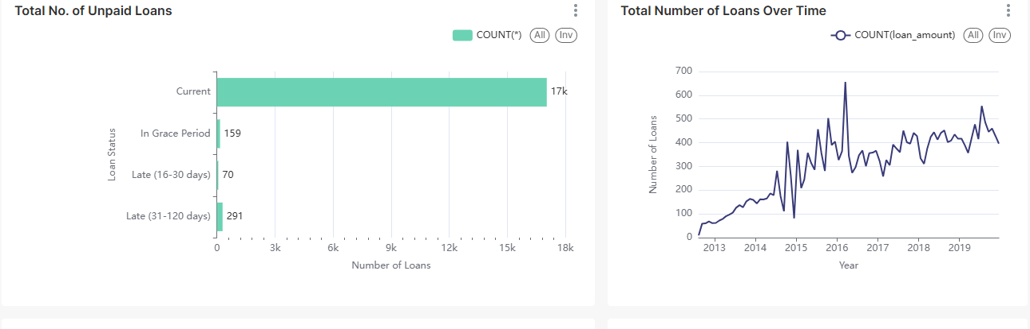
Superset Dashboard

Slide 10
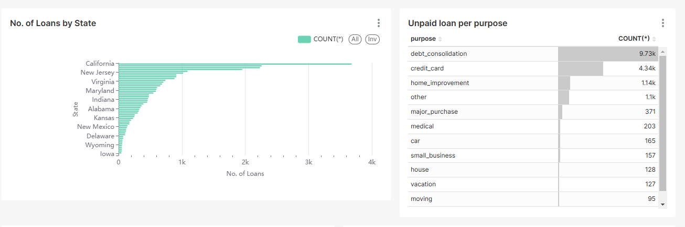
Superset Dashboard

Slide 11
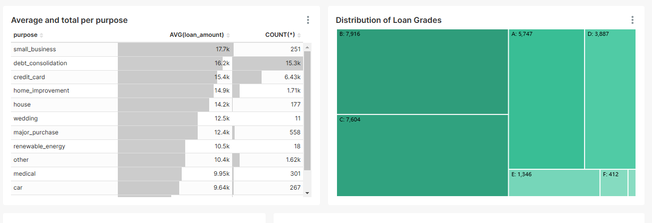
Superset Dashboard

Slide 12
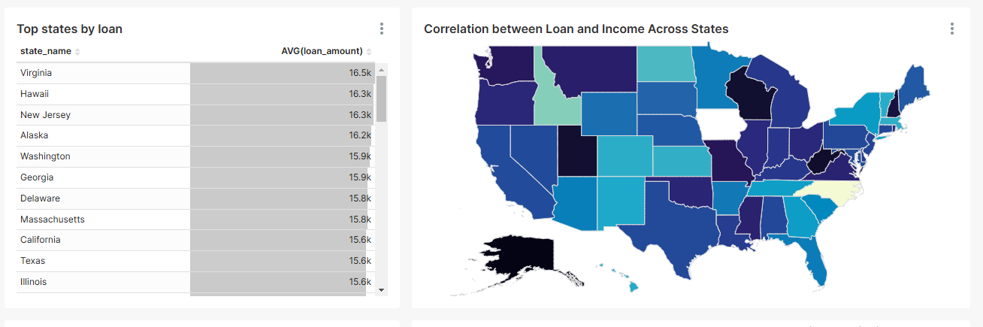
Superset Dashboard

Slide 13
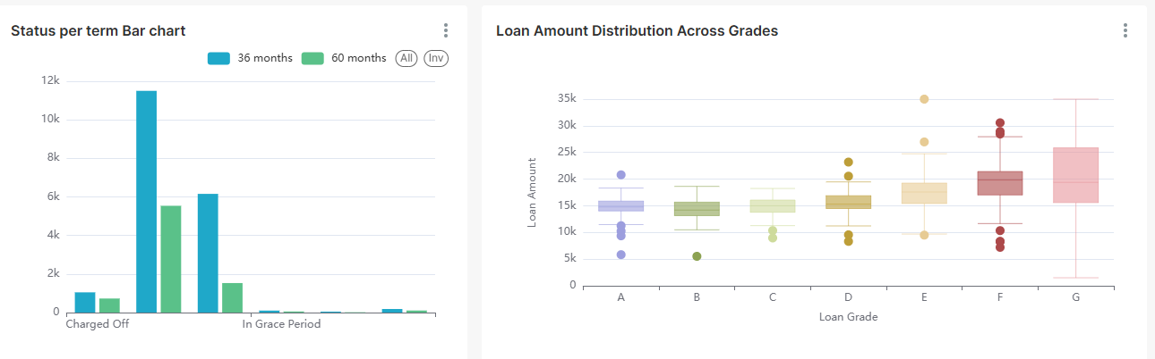
Superset Dashboard

Slide 14
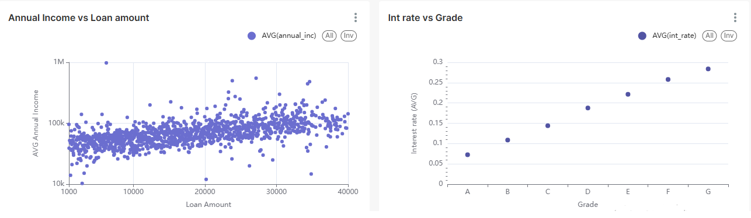
Superset Dashboard

Slide 15
THANK YOU

